Slide 1
MicrMicroservices and containers

Slide 2
Monolithic and Microservices
There has been a lot of change in the development & deployment since the ’80s till now. We can trace the evolution of how organizations have developed, deployed, and managed applications over three distinct phases:

Slide 3
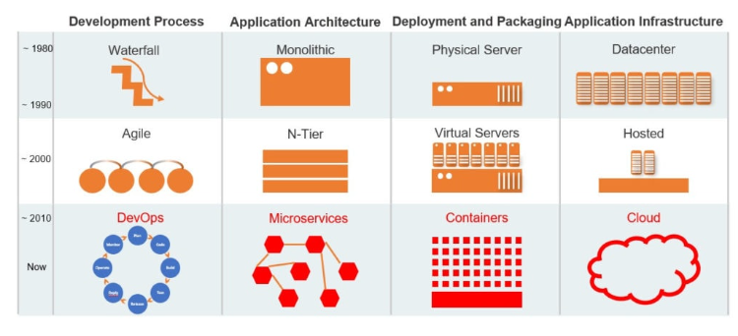

Slide 4
80’s – mid 90’s: Data Centers with physical servers, running monolithic applications, developed using traditional waterfall methodologies.
Late 90s–00s: Datacenters and hosting providers running Unix/Linux servers, the emergence of virtualization (VMWare, KVM), running n-tier applications, developed using agile methodologies.
~ 2010 – Now: Cloud increasingly replacing data centers and hosting, decomposition of applications into microservices, running on a container infrastructure, managed and orchestrated by Kubernetes, developers, and operations collaborating using DevOps methodologies.

Slide 5
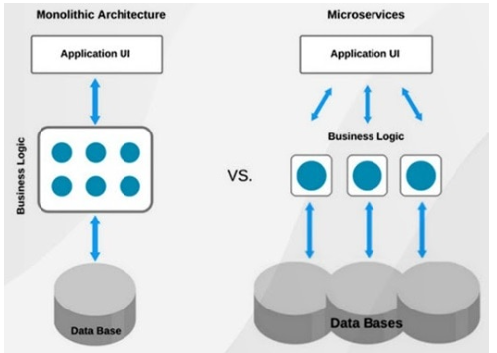

Slide 6
Monolithic Application
A monolithic application is constructed as one unit which means it’s composed all in one piece. The Monolithic application describes a one-tiered software application within which different components combined into one program from a single platform. The three components are the user interface, the data access layer, and the data store.
The user interface is the entry point of the application and is also the point of the program that a user will interact with.
Data access layer is the layer of the program which will wrap the data stored.
The data store is the most fundamental part of the system and is liable for storing data and retrieving it.

Slide 7
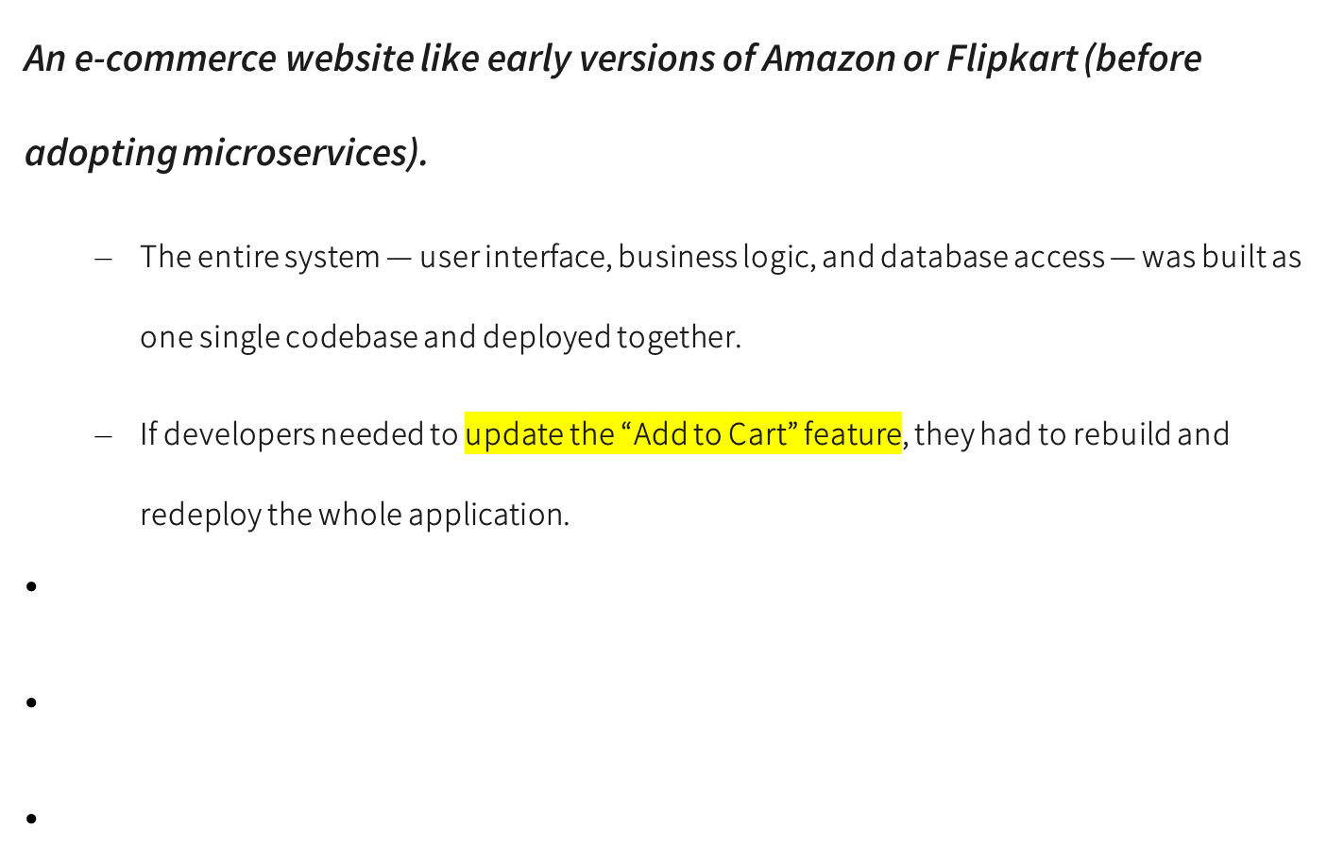
Example of a Monolithic Application

Slide 8
1. User Interface (UI) Example
Example: The web pages or app screens that customers use to browse products, view prices, and click “Buy Now.”
This part displays information to users and collects their input.
Technologies (example): HTML, CSS, JavaScript (front-end built into the same application).

Slide 9
2. Data Access Layer Example
Example: A set of functions or modules in the application that handle communication between the UI and the database.
  For instance, a ProductDAO class (Data Access Object) retrieves product details from the database.
Technologies (example): Java JDBC, Python’s SQLAlchemy, or .NET Entity Framework within the same codebase.

Slide 10
3. Data Store Example
Example: A relational database like MySQL or PostgreSQL that stores all data — user accounts, product details, and orders.
The application connects directly to this single database to read and write data.

Slide 11
Advantages of Monolithic:
Simple to deploy – In monolithic applications, we don’t need to handle many deployments just one file or directory.
Easier debugging and testing – monolithic applications are much easier to debug and test. Since a monolithic app is a single indivisible unit, we can run end-to-end testing much faster.
Performance: Components in a monolith typically share memory which is Quicker than service-to-service communications.

Slide 12
Disadvantages of Monolithic:
New technology barriers – It’s extremely problematic to use new technology in a monolithic application because then the whole application must be rewritten.
Scalability- You can’t scale components independently, only the whole application.
Size – It becomes overlarge in size with time and becomes difficult to manage.
Difficult to understand – For any new developer joining the project, it’s very difficult to grasp the logic of an oversized monolithic application whether or not his responsibility is related to one functionality.

Slide 13
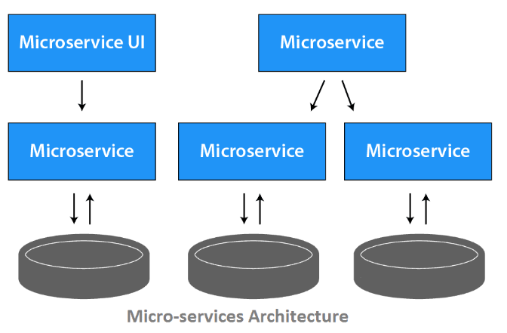

Slide 14
a) The idea of microservices is to separate our application into smaller sets and interconnected services rather than building one monolithic application.
b) Each module supports a selected business goal and uses a simple and well-defined interface to communicate with other sets of services.
c) Each microservice has its own database. Having a database per service is crucial if you wish to learn from microservices because it ensures loose coupling.

Slide 15
Example of a Microservices Application
Example: Modern Amazon or Netflix
  Instead of one large application, they’re made up of many small services, such as:
    User Management Service
    Product Catalog Service
    Payment Service
    Order Tracking Service
    Recommendation Service
  Each service runs independently but communicates with others using APIs.

Slide 16
Smaller and Interconnected Services
Example:
  In an online shopping platform, separate services are built for:
    User Service → handles login, signup, profile.
    Order Service → manages order placement and history.
    Payment Service → processes payments and refunds.
  These services communicate using REST APIs or message queues.

Slide 17
Each Module Supports a Business Goal
Example:
  The Payment Service has one clear goal: handle all payment transactions.
  The Inventory Service focuses only on updating and managing stock levels.
  Each module (microservice) does one thing well and can be developed, deployed, and scaled independently.
Communication Example:
  When a user places an order, the Order Service calls the Payment Service via an API like:
  POST /payment/process
  The Payment Service confirms the transaction and notifies the Order Service to proceed.

Slide 18
Each Microservice Has Its Own Database
Example:
  User Service Database (MySQL): Stores usernames, emails, passwords.
  Order Service Database (MongoDB): Stores order details, product IDs, delivery status.
  Payment Service Database (PostgreSQL): Stores payment transactions and invoices.
This ensures loose coupling — one service can change its database or schema without affecting others.

Slide 19
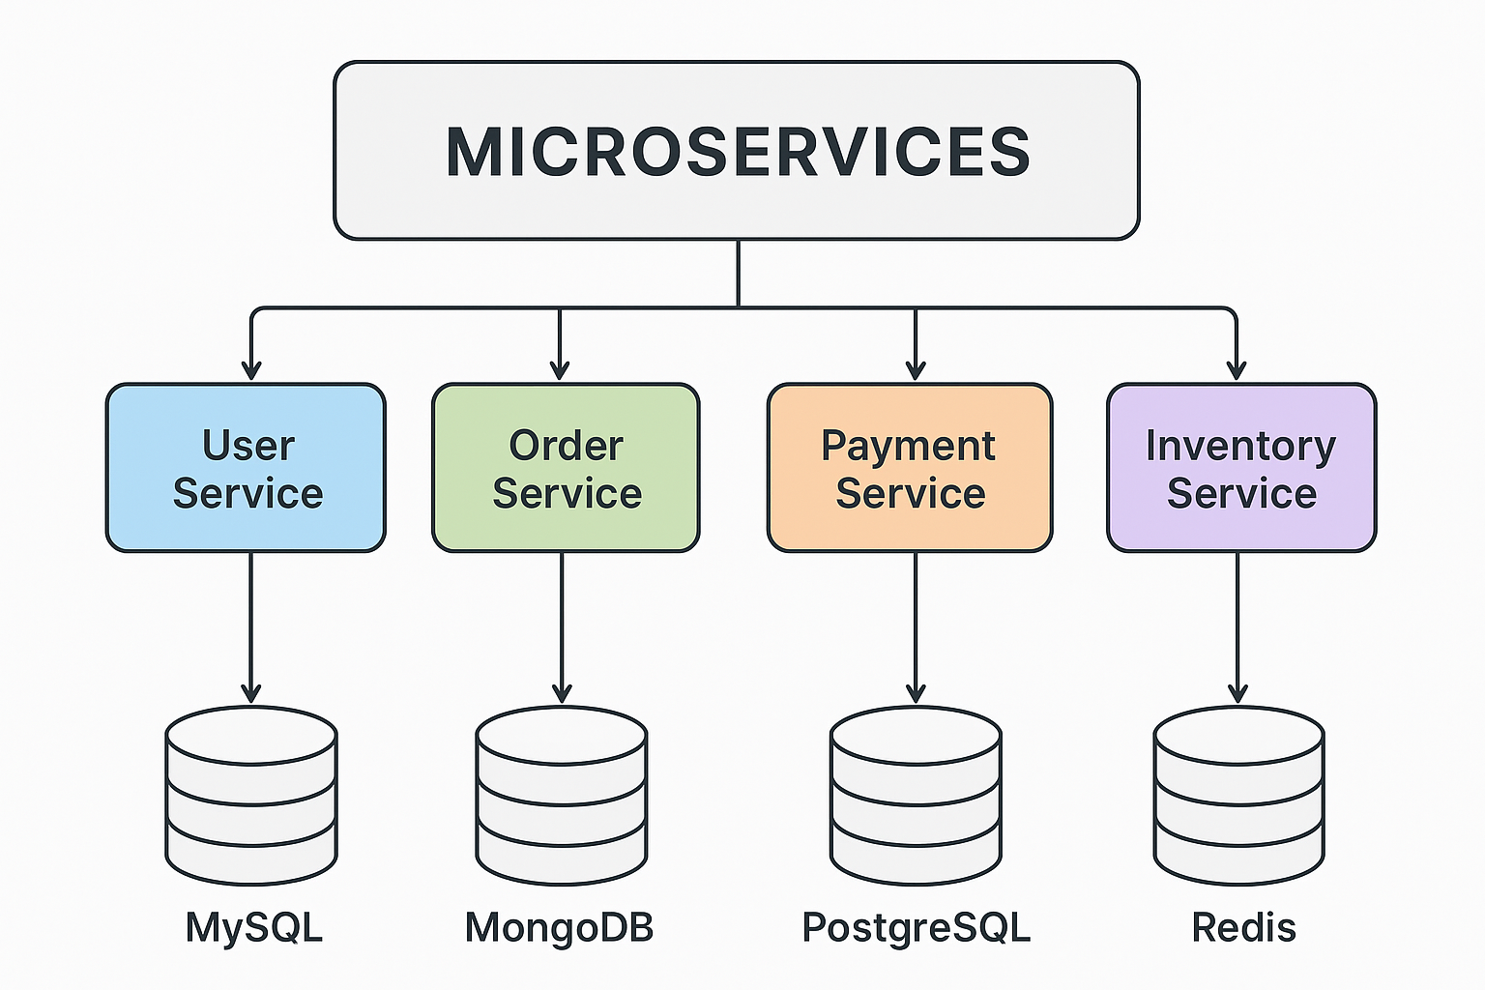
Other Example :
Online Food Delivery App (Microservices Example):

Slide 20
Advantages of Microservices:
Advantage | Explanation | Example | Benefit
1. Scalability | Each microservice can be scaled independently based on demand. | During festive sales, only the Order Service is scaled up while others remain constant. | Efficient resource use and better performance.
2. Independent Deployment | Teams can deploy or update one microservice without redeploying the whole system. | Payment Service is updated for new payment gateway without affecting User or Order services. | Faster updates and reduced downtime.
3. Technology Flexibility | Each service can use a different tech stack suitable for its task. | User Service in Python, Order Service in Java, Payment Service in Node.js. | Freedom to choose best-fit tools and technologies.

Slide 21
4. Fault Isolation | A failure in one service does not crash the entire application. | If Recommendation Service fails, other services like Order and Payment still work. | Increased reliability and system uptime.
5. Faster Development & Deployment | Smaller, independent teams can develop, test, and deploy services in parallel. | One team works on Inventory, another on Payment, both releasing updates independently. | Accelerates innovation and delivery speed.
6. Easier Maintenance & Debugging | Each service is smaller and easier to test or fix. | Bugs in User Service can be fixed quickly without touching other modules. | Simplifies debugging and reduces risk.

Slide 22
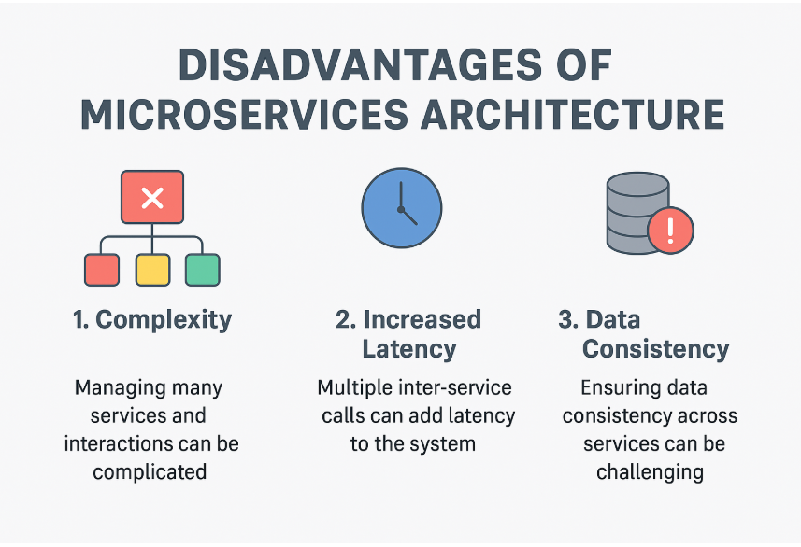


Slide 23
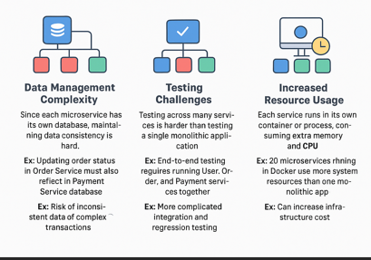

Slide 24
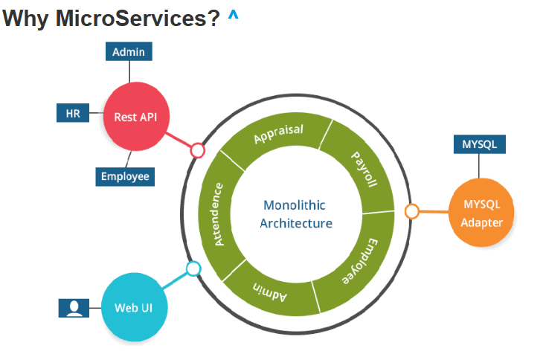

Slide 25
The good thing about using microservices is that development teams are ready to rapidly build new components of apps to fulfill changing business needs.
In microservices, every application resides in separate containers along with the environment it needs to run.
It allows it to maximize deployment velocity and application reliability.
There’s no risk of interfering with the other applications. It also allows optimizing the sources micro services multiply team works on independent services.

Slide 26
In Microservices, we run all the applications on Containers (Docker), so the boot-up time and memory consumption of applications decrease, thus the performance of the application increases.
In organizations, not one or two but multiple numbers of Containers (Docker) are running.
So, to manage them, we use Kubernetes. Kubernetes comes in handy because it provides various facilities like self-healing, scalability, auto-scaling, and declarative state.

Slide 27
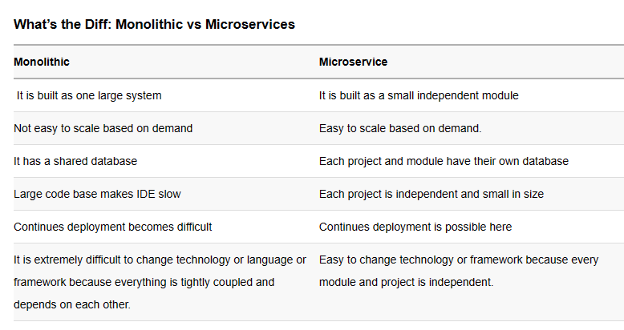

Slide 28
Point of Discussion
1. If an online shopping platform on AWS faces high demand for its payment service, how would scaling differ for monolithic vs. microservices architecture?
2. Can you explain what happens during a big sale event—how might microservices help Flipkart manage traffic surges differently than a monolithic system?

Slide 29
Concept of Containers
Containers are Operating System-level virtualization technologies that allow multiple isolated applications to run on a single host or instance.
They provide agile, cost efficient, and automated application deployment in which processes are packaged with all the necessary dependencies inside their own separate instances for easy access and portability.
Containers also offer greater levels of isolation between resources and improve resource utilization compared to traditional virtual machines by using fewer hardware resources.

Slide 30
Containers are a lightweight alternative to VMs for providing isolated operating environments for your workloads.
They use a different method of abstracting resources.
Instead of using a hypervisor, containers share the kernel of the host operating system (OS).
As a result, they avoid the infrastructure overhead of a full-blown OS and provide only those resources (i.e., installations, dependencies, and code) that your applications actually need.
This means they can stop and start more quickly in response to fluctuating scaling requirements and offer better overall performance than VMs.

Slide 31
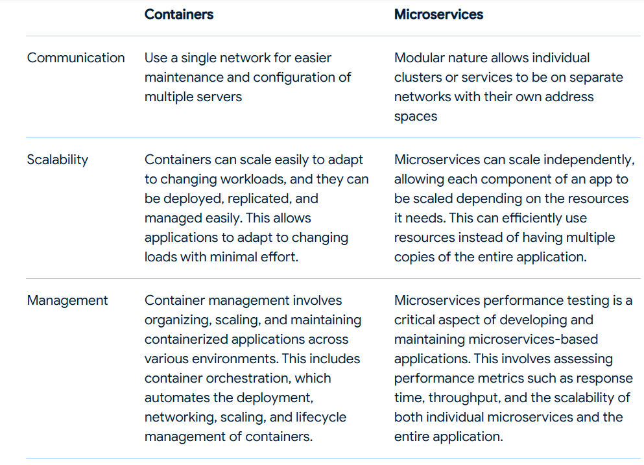

Slide 32
Containers and microservices
Containers and microservices are two important technologies driving the future of development.
While they share many similarities, there are key differences that must be understood when determining which approach is right for an application.
Containers enable portability and resource efficiency while offering great scalability options through containerization technology such as Docker or Kubernetes.
On the other hand, Microservices allow flexibility due to their modular design, allowing applications to scale up without major changes in architecture all the while leveraging communication between services over a network connection; this also makes DevOps easier than ever before!

Slide 33
To better performance and a lower infrastructure footprint, containerized microservices are typically more robust than a traditional monolithic application.
For example, if you deploy an entire application to a VM, when the machine goes down, the whole application goes down with it. But, with containers, you can replicate microservices across a cluster of smaller VMs.
So, in the event of a VM failure, the application will still be able to use the other microservices in the cluster and continue to function.

Slide 34
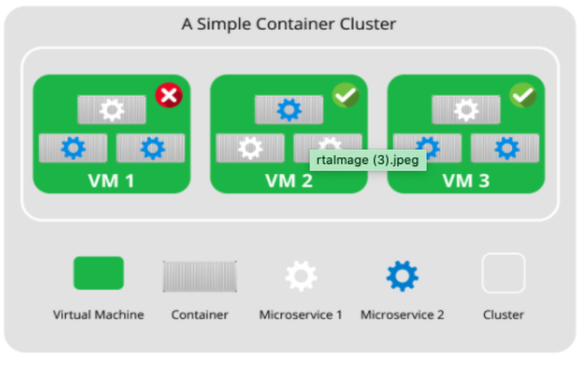

Slide 35
Microservices → Many services → Many containers.
Docker Compose helps:
✔ Define multiple services
✔ Manage networking
✔ Control dependencies
✔ Scale services
✔ Reproduce architecture easily
Compose = Practical enabler of microservices (especially in dev/testing)

Slide 36
Docker Compose
Docker Compose is a tool used to define and manage multi-container
Docker applications using a YAML configuration file.
Key idea:
✔ Instead of running containers individually
✔ Define the entire application stack declaratively

Slide 37
Conceptual Understanding
Docker alone:
Runs individual containers
Docker Compose:
Manages groups of related containers
Its like:
Docker = Container-level management
Docker Compose = Application-level management

Slide 38
Docker Compose follows:
✔ Declarative configuration
✔ Infrastructure as Code
✔ Reproducibility
✔ Automation

Slide 39
Need of Docker Compose
Problem Without Compose
Modern applications rarely use a single container.
Typical stack:
✔ Web application
✔ Database
✔ Cache
✔ Backend API
✔ Message queue
Running manually:
docker run web
docker run db
docker run redis
docker run backend

Slide 40
Problems faces
Too many commands
✖ Hard to remember parameters
✖ Hard to reproduce setup
✖ Networking complexity
✖ Dependency issues

Slide 41
How docker solve the problem
(A) Multi-Container Management
Define entire system in one file.
✔ Centralized configuration
✔ Single command execution
(B) Reproducibility
Very strong academic point.
✔ Same environment across machines
✔ Same configuration for all developers
“Works on my machine” problem → minimized.

Slide 42
(C) Simplified Networking
Without Compose:
✖ Manual network creation
✖ IP management
With Compose:
✔ Automatic network creation
✔ Services communicate via names
Example:
Service db reachable at hostname db.
Huge conceptual advantage.

Slide 43
(D) Dependency Management
Control startup order.
✔ Web depends on DB
✔ Backend depends on Cache
Compose manages orchestration basics.

Slide 44
(E) Scalability
Scale services easily.
docker compose up --scale web=3
✔ No manual container duplication
(F) Cleaner Configuration
Instead of:
docker run -d -p 8080:80 --name web ...
You define:
ports:
- "8080:80"
✔ Human-readable
✔ Version-controlled

Slide 45
3. Basics of Docker Compose
Now move to fundamental building blocks.
(A) Compose File (docker-compose.yml)
Heart of Compose.
✔ Written in YAML
✔ Defines application stack
Basic structure:
version: "3.9"
services:
service_name:
configuration
Important teaching note:
YAML = indentation-sensitive
Spacing matters

Slide 46
(B) Services (Most Important Concept)
Service = Definition / Blueprint of containers
NOT containers directly.
Example:
services:
web:
image: nginx
Conceptually:
✔ Service defines role
✔ Container = Instance of service
Analogy:
Class → Object
Service → Container

Slide 47
(C) image vs build
Two ways to specify container source.
Using Prebuilt Image
image: nginx
✔ Pull from registry
Building Custom Image
build: .
✔ Uses Dockerfile
✔ Builds locally
Theory distinction:
✔ image → Existing software
✔ build → Custom software

Slide 48
(D) ports
Defines host-container communication.
ports:
- "8080:80“
Explain carefully:
✔ HostPort : ContainerPort
Common student confusion → directionality.

Slide 49
(E) volumes
Persistent storage.
volumes:
- data:/var/lib/mysql
Concept:
✔ Containers ephemeral
✔ Volumes persistent
Benefits:
✔ Data safety
✔ State preservation

Slide 50
(F) networks
Compose automatically creates:
✔ Default network
Conceptual advantages:
✔ Service discovery
✔ Built-in DNS
✔ Name-based communication
Example:
web → connect to db via hostname db

Slide 51
(G) depends_on
Controls startup order.
depends_on:
- db
VERY IMPORTANT theory clarification:
✔ Ensures start order
✖ Does NOT ensure readiness

Slide 52
How Docker Compose Works
Compose performs:
Reads YAML file
Pulls/builds images
Creates network(s)
Creates volumes
Starts containers
Connects services
Emphasize:
Compose automates container lifecycle management.

Slide 53
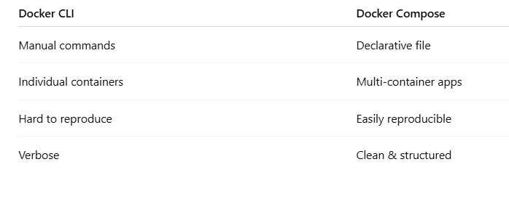
Docker Compose vs Docker CLI

Slide 54
Basic Commands
Initialization & Setup
docker-compose version
→ Check installed version
docker-compose config
→ Validate YAML file syntax
Create the file : notepad docker-compose.yml
version: "3.9"
services:
web:
image: nginx
ports:
- "8080:80"

Slide 55
Starting Services
docker-compose up
→ Start all services (foreground)
docker-compose up -d
→ Start in detached mode (background)
docker-compose up --build
→ Rebuild images before starting

Slide 56
Stopping Services
docker-compose down
→ Stop & remove containers, networks
docker-compose stop
→ Stop containers (no removal)
docker-compose start
→ Restart stopped containers
Monitoring & Debugging
docker-compose ps
→ List running services
docker-compose logs
→ View logs
docker-compose logs -f
→ Live logs

Slide 57
Executing Commands
docker-compose exec <service> bash
→ Enter container shell
docker-compose up --scale web=3
→ Run multiple instances

Slide 58
A company wants to deploy a 3-tier web application using Docker Compose:
Frontend → React (Node.js)
Backend → Spring Boot API
Database → PostgreSQL
Requirements:
All services must communicate
Environment variables should be used
Data should persist using volumes
Services must start in dependency order

Slide 59
Create docker-compose.yaml file
docker compose up –d
docker compose config --services
docker exec -it postgres-db psql -U postgres- check database

Slide 60
Create a Docker Compose setup for a Node.js application connected to MongoDB.
Requirements:
Node.js app runs on port 3000
MongoDB runs on default port 27017
Use environment variables for DB connection
Ensure MongoDB starts before Node.js

Slide 61
version: '3.8'
services:
app:
image: node:18
container_name: node-app
working_dir: /usr/src/app
volumes:
- .:/usr/src/app
command: npm start
ports:
- "3000:3000"
environment:
- MONGO_URL=mongodb://mongo:27017/mydb
depends_on:
- mongo
mongo:
image: mongo:6
container_name: mongo-db
ports:
- "27017:27017"
volumes:
- mongo-data:/data/db
volumes:
mongo-data:

Slide 62
docker compose up -d
docker compose ps
docker compose logs app
docker compose down

Slide 63
Deploy a WordPress website using Docker Compose with MySQL as the database.
Requirements:
WordPress runs on port 8080
MySQL uses persistent storage
Use environment variables for DB configuration
Ensure proper service dependency

Slide 64
version: '3.8'
services:
wordpress:
image: wordpress:latest
container_name: wordpress-app
ports:
- "8080:80"
environment:
WORDPRESS_DB_HOST: db:3306
WORDPRESS_DB_USER: wpuser
WORDPRESS_DB_PASSWORD: wppass
WORDPRESS_DB_NAME: wpdb
depends_on:
- db
db:
image: mysql:5.7
container_name: mysql-db
restart: always
environment:
MYSQL_DATABASE: wpdb
MYSQL_USER: wpuser
MYSQL_PASSWORD: wppass
MYSQL_ROOT_PASSWORD: rootpass
volumes:
- db-data:/var/lib/mysql
volumes:
db-data:

